Slide 1

My Linear Relationships Interactive Notebook
Name
Class
Term 3 Semester 2

Slide 2
Contents
Formula Page
Page
Date
Description
2
3

Slide 3
Tasks
24
7
30
Essential Question
Questions
Notes
Summary
6
7

Slide 4
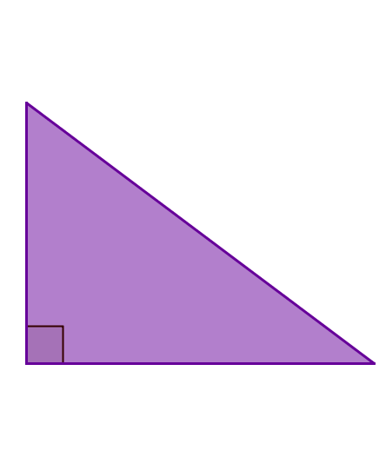

24
7
30
Date
Finding the shorter sides
EQ – How do I use Pythagoras theorem to find a side that is not the hypotenuse in a right angled triangle?
Pythagoras’ Theorem
$$a^{2}+b^{2}=c^{2}$$
7

Slide 5
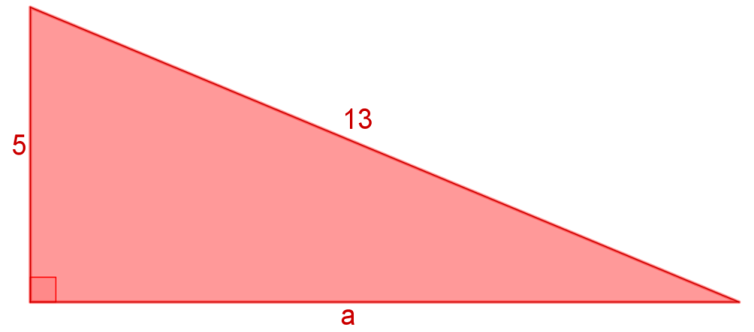
24
7
30
Date
Finding the shorter sides
EQ – How do I use Pythagoras theorem to find a side that is not the hypotenuse in a right angled triangle?
Pythagoras’ Theorem
$$a^{2}+b^{2}=c^{2}$$
e.g Find the length of a.
7

Slide 6
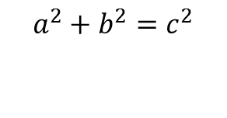
24
7
30
Date
Finding the shorter sides
EQ – How do I use Pythagoras theorem to find a side that is not the hypotenuse in a right angled triangle?
Pythagoras’ Theorem
$$a^{2}+b^{2}=c^{2}$$
e.g Find the length of a.
$$a^{2}+b^{2}=c^{2}$$
7

Slide 7
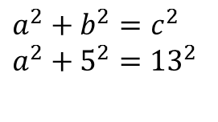
24
7
30
Date
Finding the shorter sides
EQ – How do I use Pythagoras theorem to find a side that is not the hypotenuse in a right angled triangle?
Pythagoras’ Theorem
$$a^{2}+b^{2}=c^{2}$$
e.g Find the length of a.
$$a^{2}+b^{2}=c^{2}$$
$$a^{2}+5^{2}={13}^{2}$$
7

Slide 8
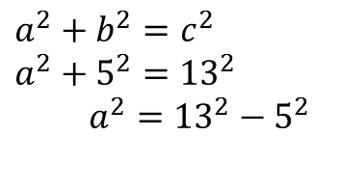
24
7
30
Date
Finding the shorter sides
EQ – How do I use Pythagoras theorem to find a side that is not the hypotenuse in a right angled triangle?
Pythagoras’ Theorem
$$a^{2}+b^{2}=c^{2}$$
e.g Find the length of a.
$$a^{2}+b^{2}=c^{2}$$
$$a^{2}+5^{2}={13}^{2}$$
$a^{2}={13}^{2}−5^{2}$
7

Slide 9
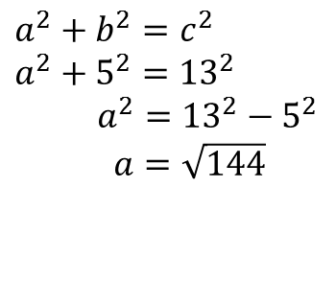
24
7
30
Date
Finding the shorter sides
EQ – How do I use Pythagoras theorem to find a side that is not the hypotenuse in a right angled triangle?
Pythagoras’ Theorem
$$a^{2}+b^{2}=c^{2}$$
e.g Find the length of a.
$$a^{2}+b^{2}=c^{2}$$
$$a^{2}+5^{2}={13}^{2}$$
$a^{2}={13}^{2}−5^{2}$
$a=\sqrt{144}$
7

Slide 10
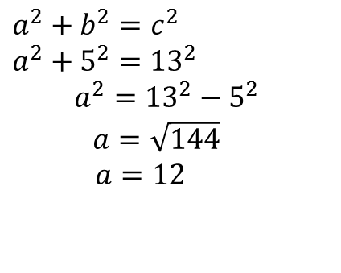
24
7
30
Date
Finding the shorter sides
EQ – How do I use Pythagoras theorem to find a side that is not the hypotenuse in a right angled triangle?
Pythagoras’ Theorem
$$a^{2}+b^{2}=c^{2}$$
e.g Find the length of a.
$$a^{2}+b^{2}=c^{2}$$
$$a^{2}+5^{2}={13}^{2}$$
$a^{2}={13}^{2}−5^{2}$
$$a=\sqrt{144}$$
$a=12$
7

Slide 11
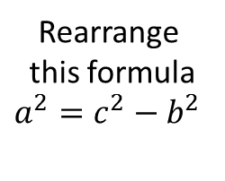
24
7
30
Date
Finding the shorter sides
EQ – How do I use Pythagoras theorem to find a side that is not the hypotenuse in a right angled triangle?
Pythagoras’ Theorem
Rearrange
this formula
$$a^{2}=c^{2}−b^{2}$$
$$a^{2}+b^{2}=c^{2}$$
e.g Find the length of a.
$$a^{2}+b^{2}=c^{2}$$
$$a^{2}+5^{2}={13}^{2}$$
$a^{2}={13}^{2}−5^{2}$
$$a=\sqrt{144}$$
$a=12$
7

Slide 12
Questions

Slide 13
Notes Review
24, 7 ,30
Date
Title
Essential question
Notes complete
Notes complete with colour and diagrams
Questions completed
Contents page filed in
Formula page filled in

Slide 14
Homework
Review your notes and write a summary answering the essential question.

